Slide 1
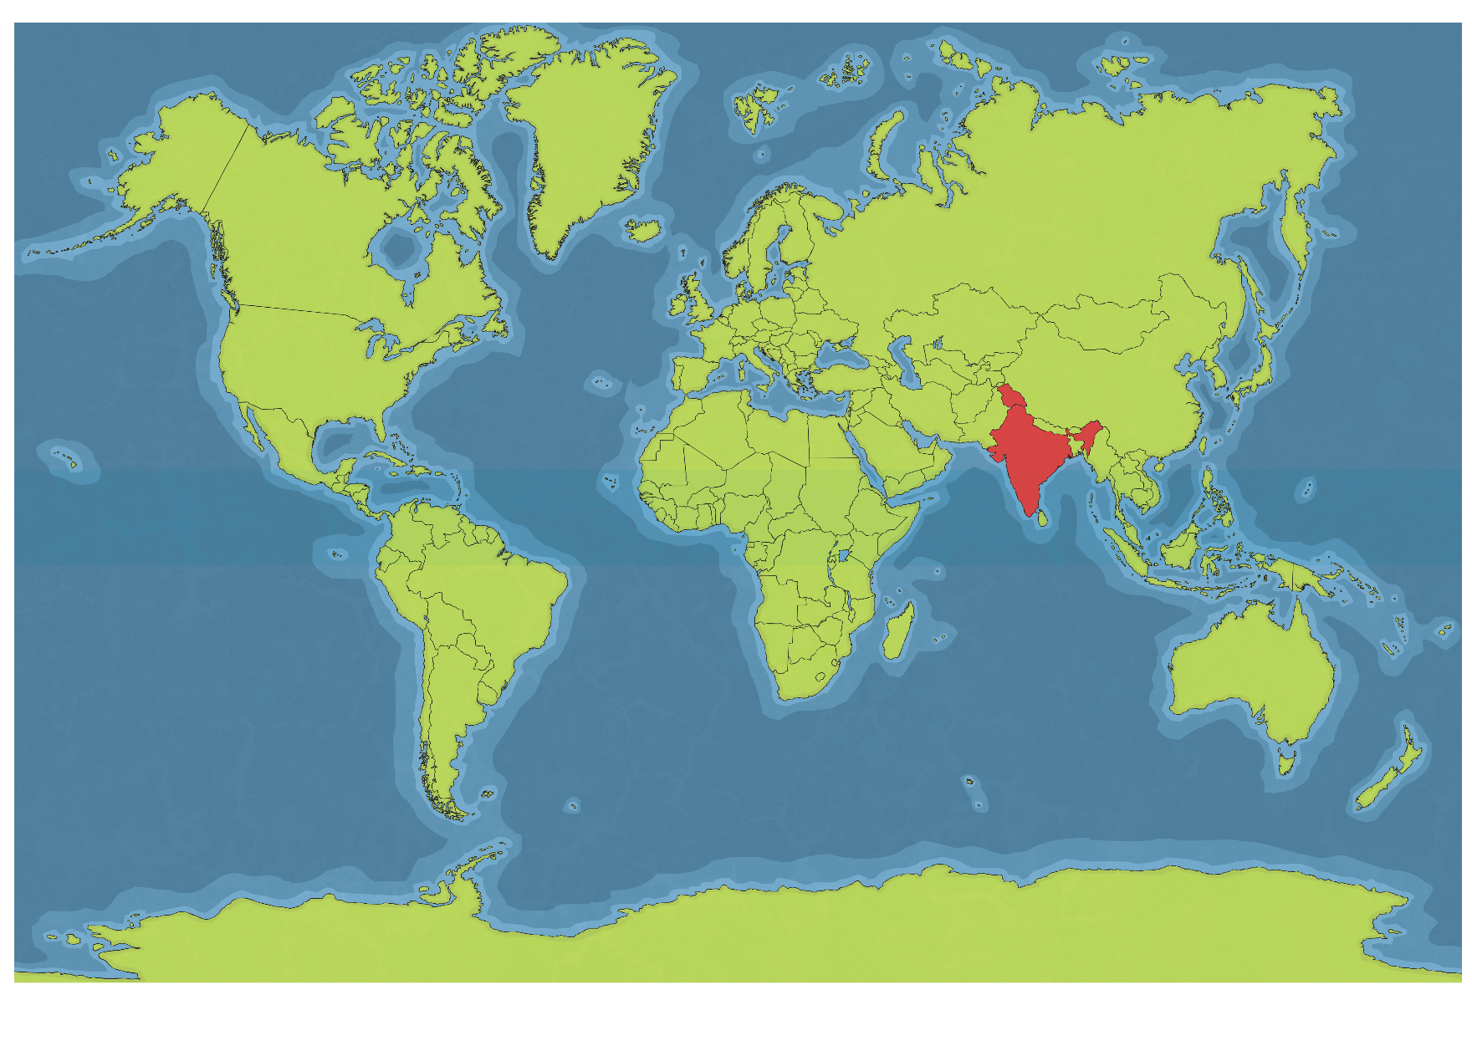
Where is India?
India is divided into 29 states.
India has a large desert called the Thar Desert.
India also borders the Himalayan mountain range, the highest mountain range in the world.
India is located in Asia. It is shaped like a diamond. It takes about 9 hours to fly to India from England.

Slide 2
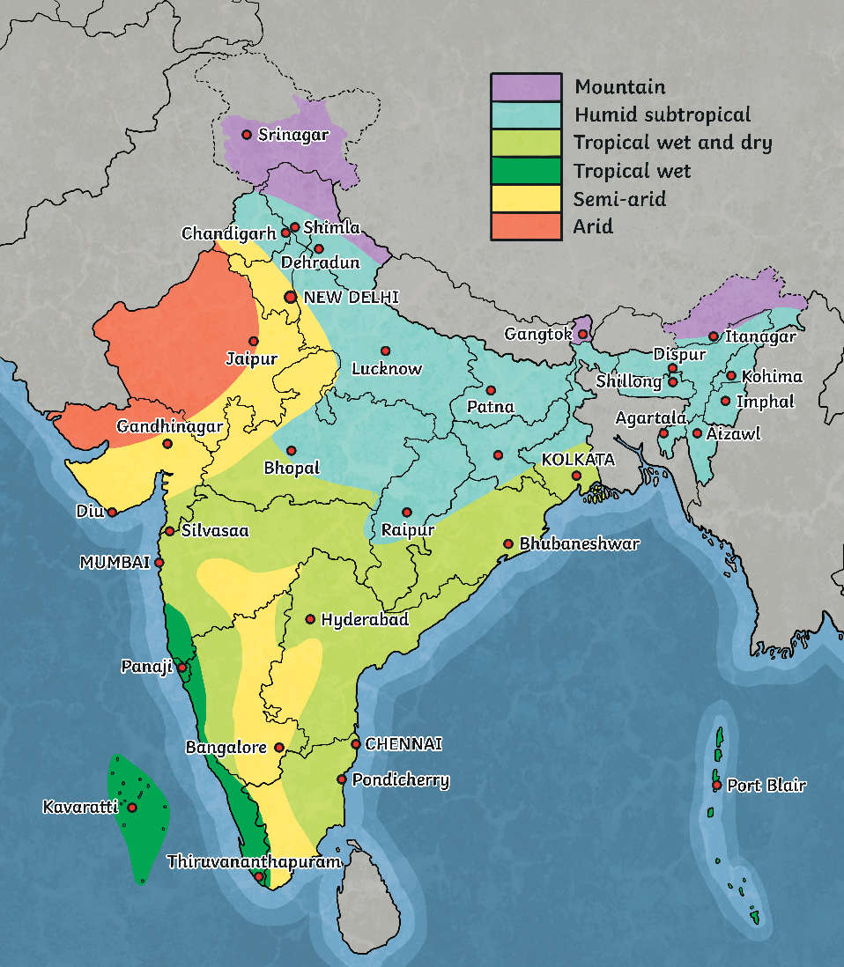
India’s Climate
India has many different types of weather because it is so large in area.
Some parts of India are very hot and dry, some are warm, and some even have a cold climate.

Slide 3
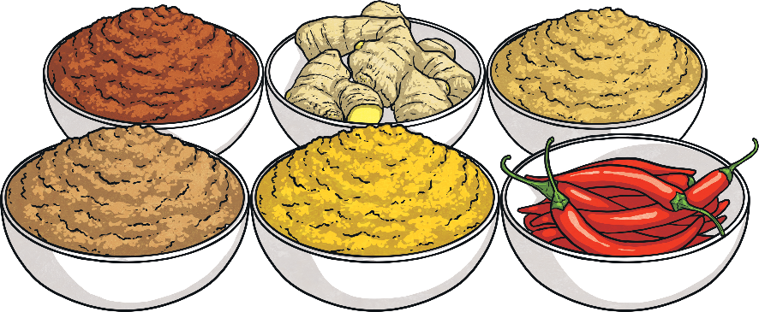
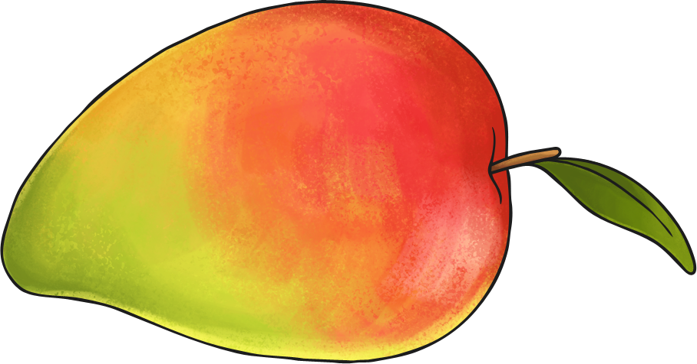
India’s Food
Since India is so diverse, its food is varied.
Rice is used in many dishes.
Lentils are also very popular.
As India is famous for its spices, food from India usually contains spices.
Common spices are curry, turmeric, and cinnamon. Garam masala is a popular spice mixture.
Mangoes and other tropical fruit are also very common in India.

Slide 4
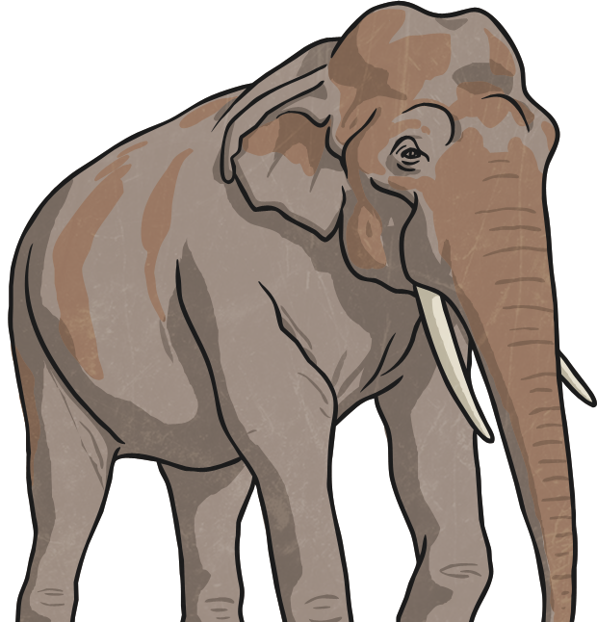
India’s Animals
India is home to many animals including:
the Bengal tiger
the Indian elephant
the Indian rhinoceros
the Indian leopard
the sloth bear
the wild water buffalo
the red panda

Slide 5
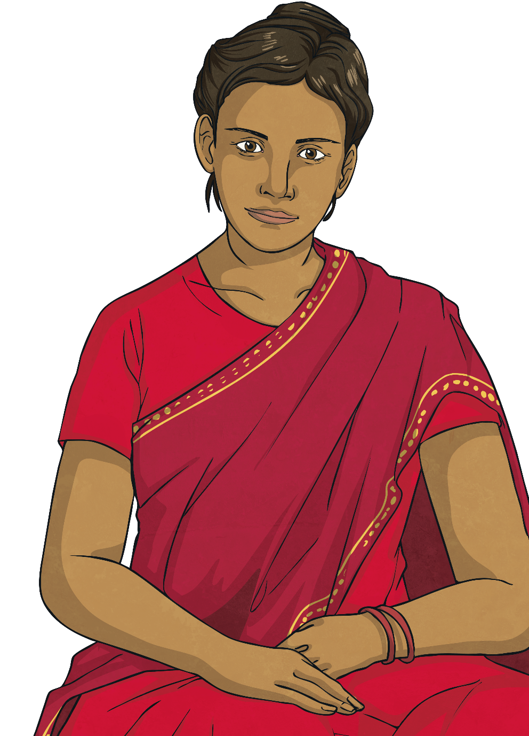
India’s Clothing
Linen and silk are popular fabrics of many Indian clothes.
An example of traditional clothing for women is the sari. It is a draped robe-like dress.
A dhoti is a traditionally draped cloth for men.
twinkl.com

Slide 6
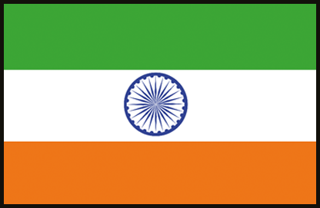
India’s Culture
India’s official language is Hindi.
Many people also speak English because India was once a British colony.

Slide 7
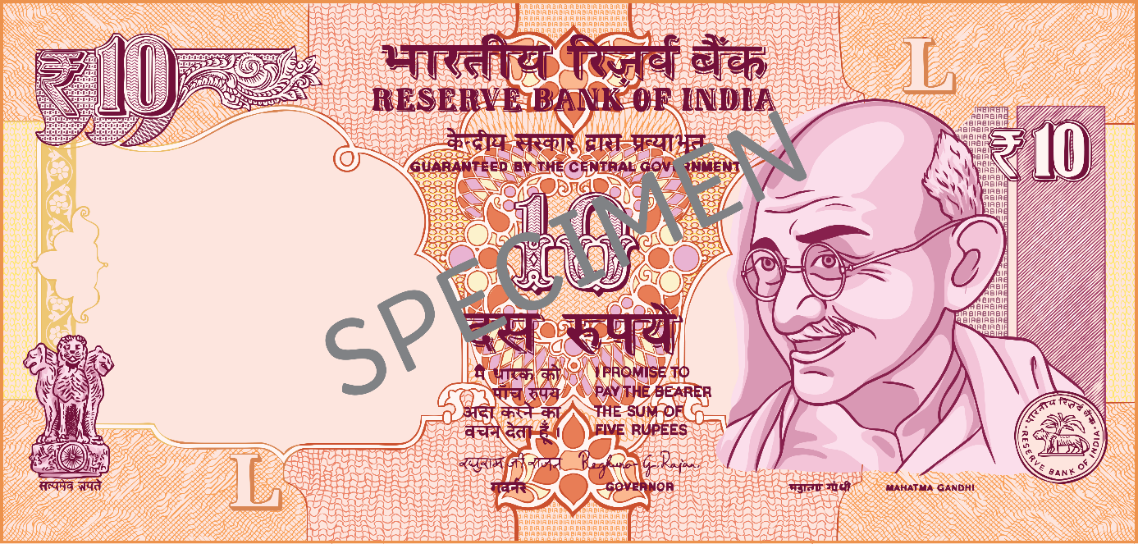
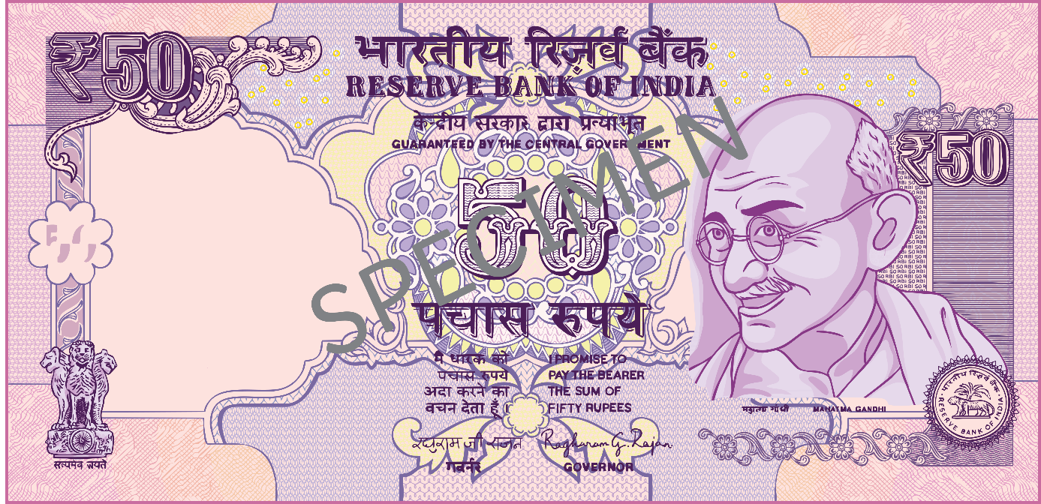
India’s Money
Rupees are the currency used in India.
The symbol is ₹.
India’s money is very colorful.

Slide 8
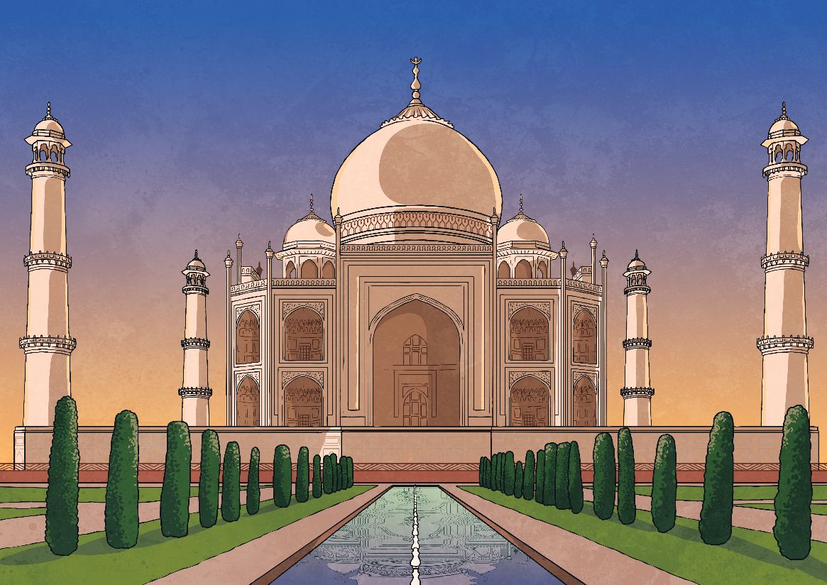
Taj Mahal
The Taj Mahal is located in Agra. It is one of the most popular tourist sites in India.
It is a world-famous site and a burial chamber for the wife of an emperor.
The Taj Mahal is constructed from white marble.
It is one of the new Seven Wonders of the World.

