Slide 1
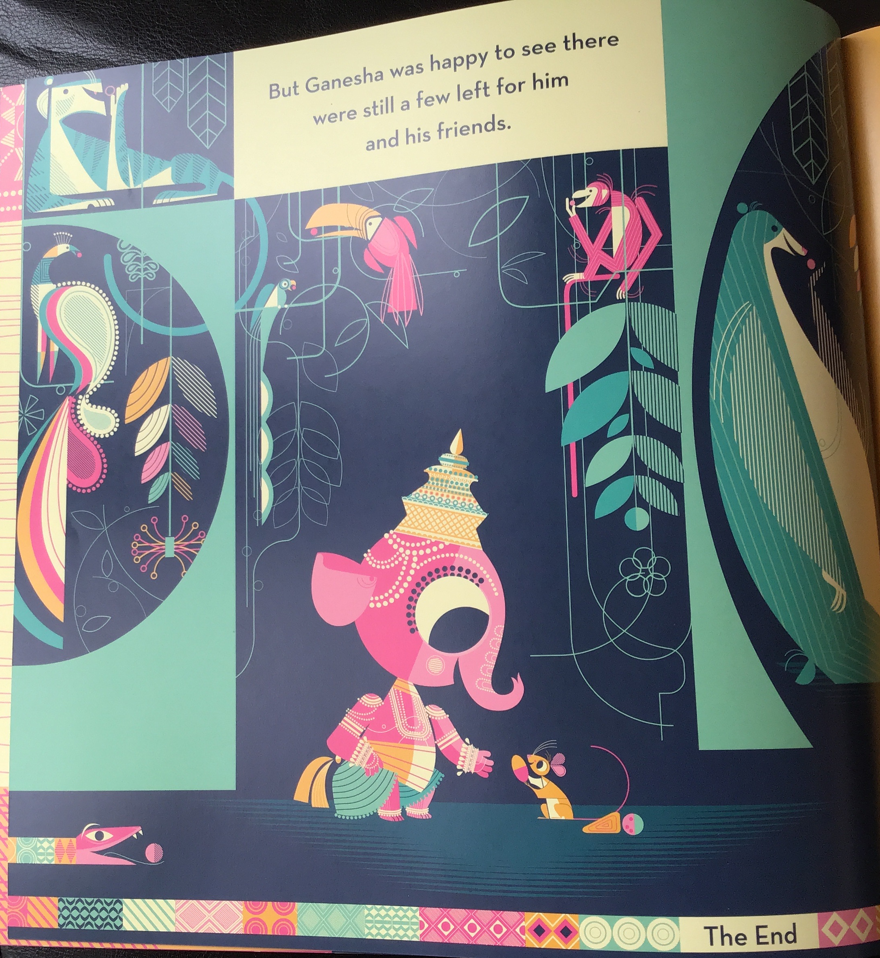
Drag the pictures into the correct order.
Can you retell the story using the pictures to help you?
Write a sentence for each picture.
1
2
3
4

