Slide 1
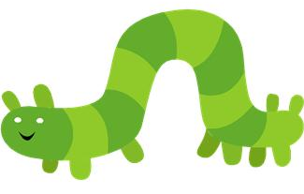
Curly caterpillar letters

Slide 2
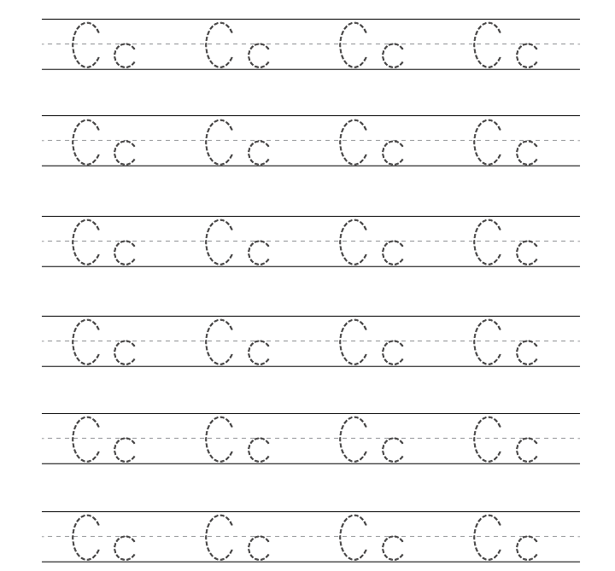
Start at the top, curl back and round.

Slide 3
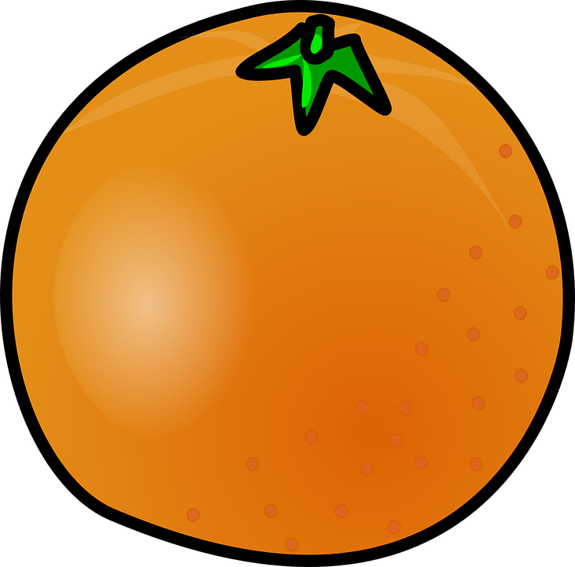
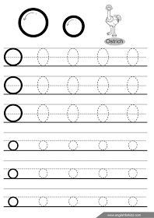
Make a curly c and then join it up.

Slide 4
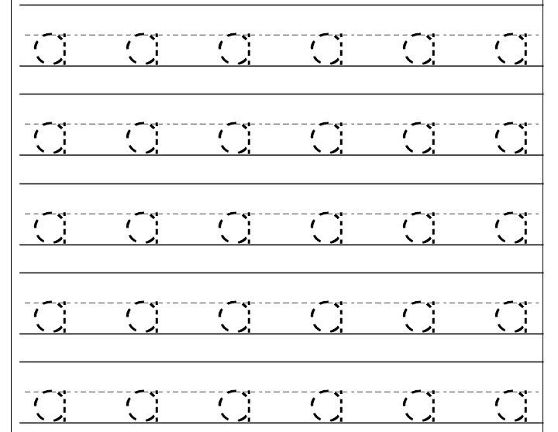
Make a curly c, join it up and give it a tail.

Slide 5
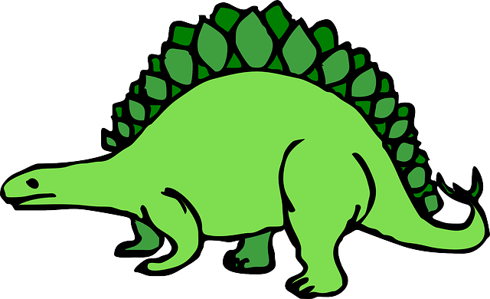
Make a curly c, join it all the way up and keep going, then all the way down.

Slide 6
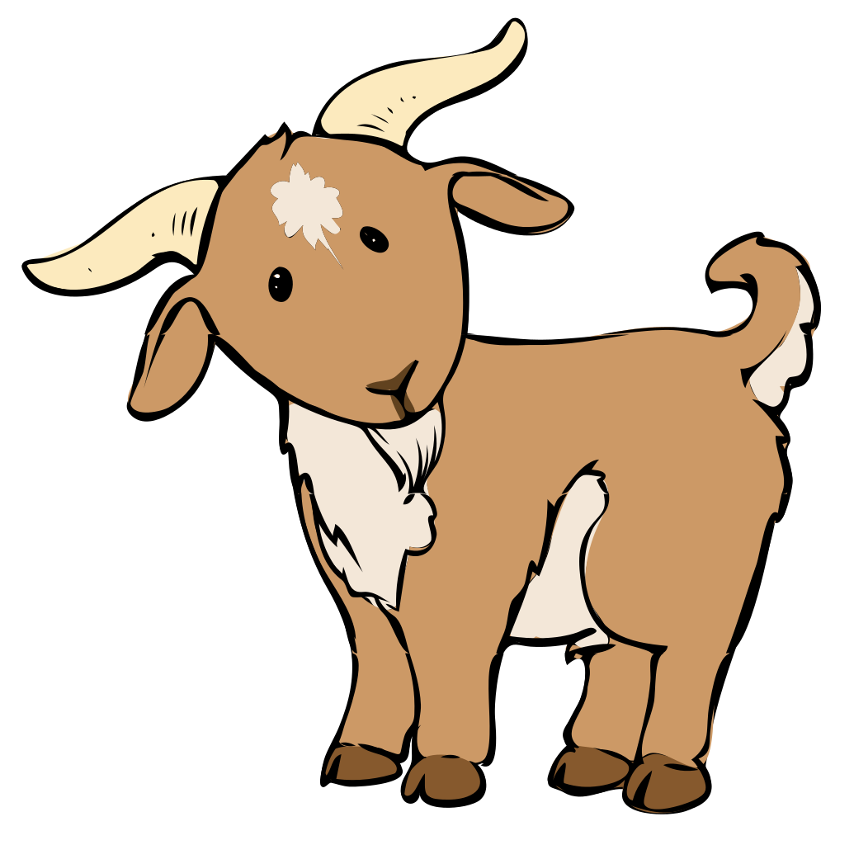
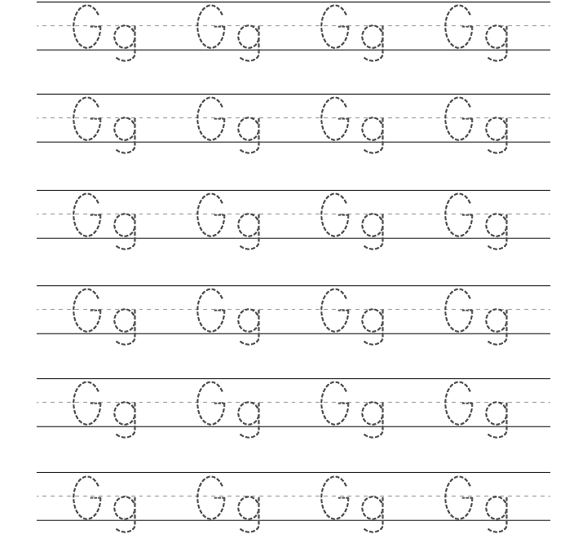
Make a curly c, join it up and then go down and curl it back.

Slide 7
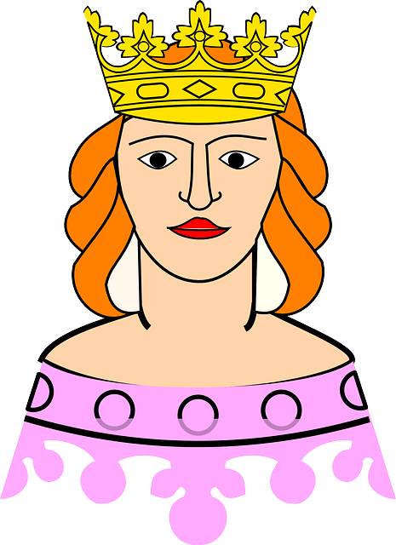
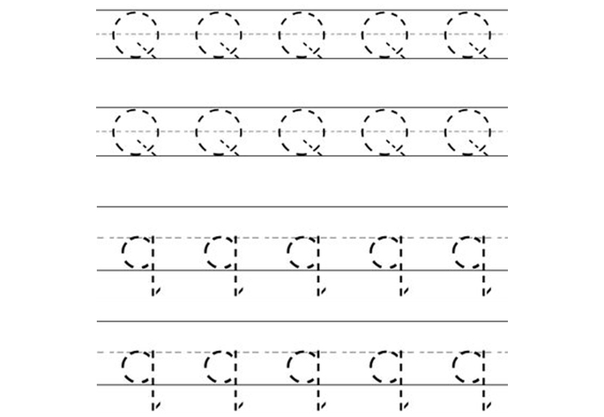
Make a curly c, join it up and then come down and give it a flick!

