Slide 1
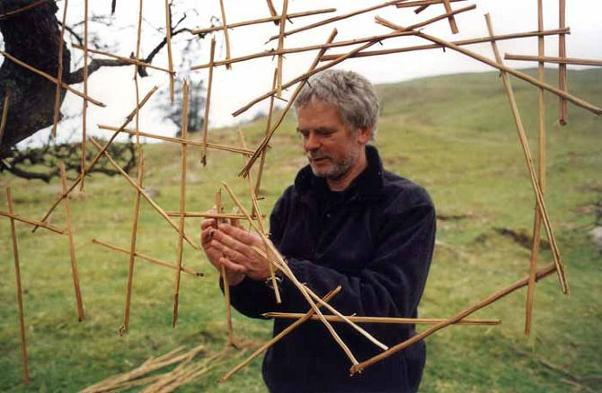
Andy Goldsworthy
Andy Goldsworthy is an artist who likes to use natural materials. He is not a painter, he is a sculptor.

Slide 2
Andy Goldsworthy
How do you think Andy Goldsworthy made this beautiful picture?
Notes:
What materials did he use? How do you think he made the black circle in the middle?

Slide 3
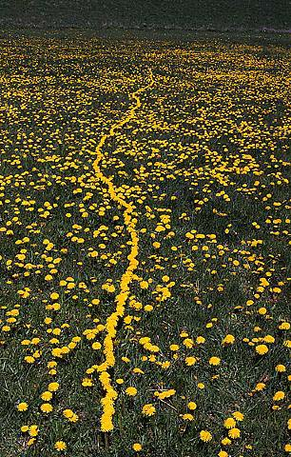
Andy Goldsworthy
What do you notice about this picture?

Slide 4
Andy Goldsworthy
What do you think this is made from?
How has he made such a pretty effect with the pebbles?

Slide 5
Andy Goldsworthy
Can you guess what this is made from?
Can you guess how he made it?

Slide 6
Andy Goldsworthy
How did Andy Goldsworthy make this swirly pattern?

