Slide 2
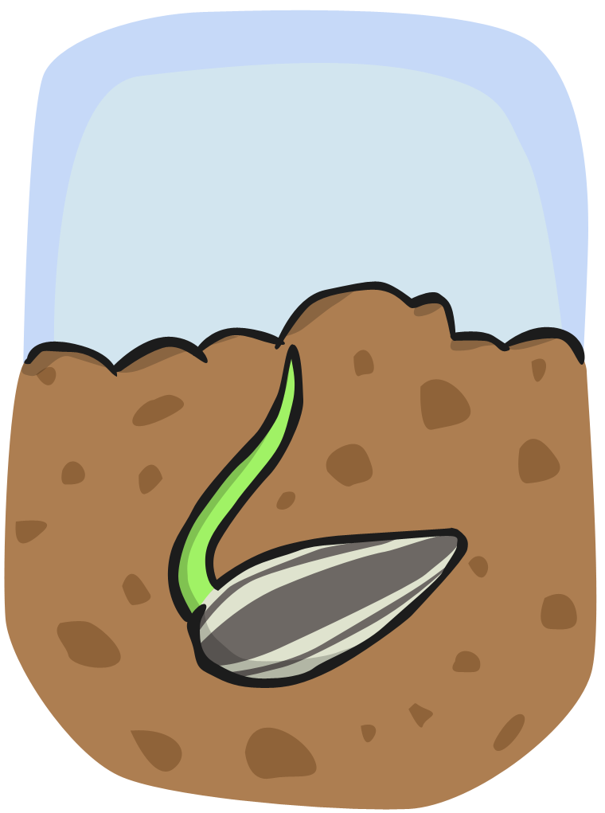
The seed case cracks open and a shoot starts to grow about a week after planting.

Slide 3
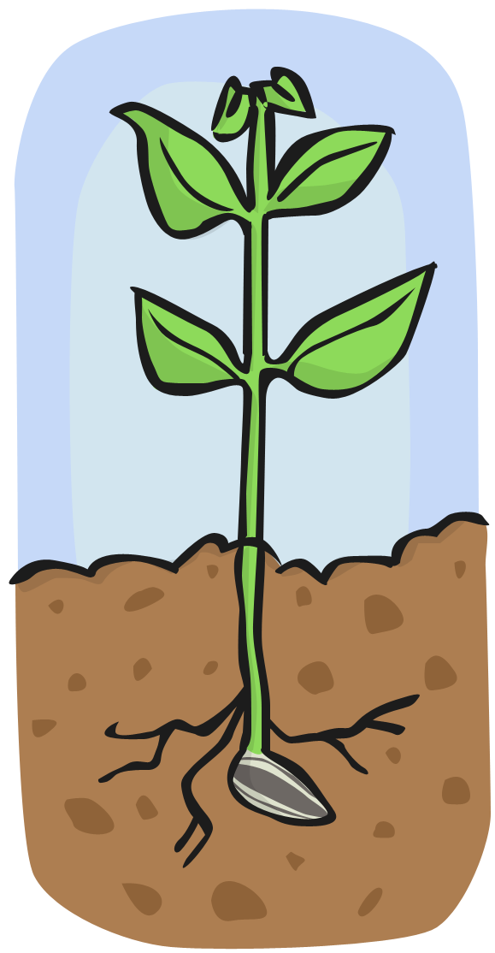
The shoot grows into a stem. A few leaves will appear. A bud begins to form.

Slide 5
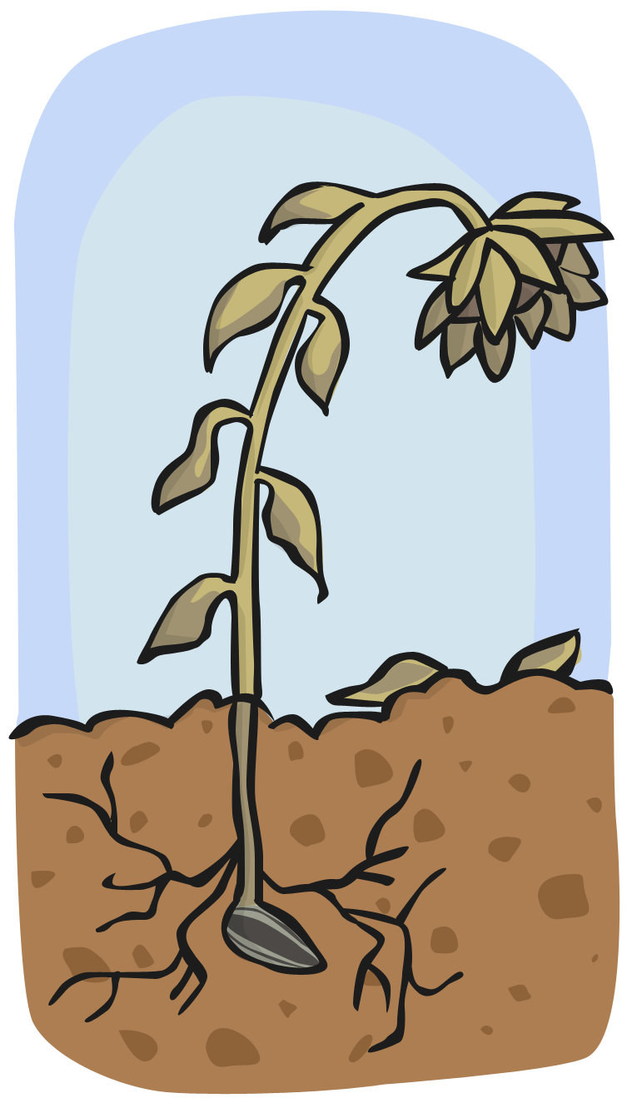

Slide 6
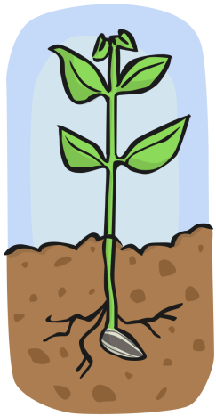
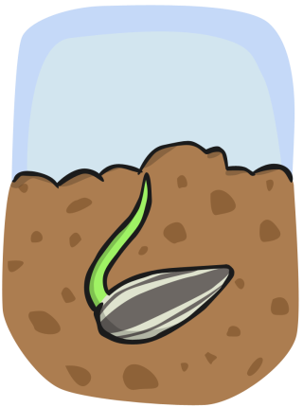
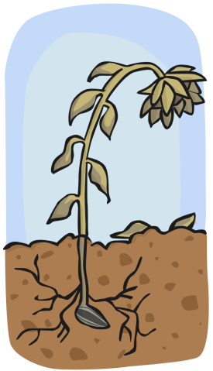

Slide 7
Use your writing tricks to fix these sentences…
the seed grows ashoot
The seed grows a shoot.

Slide 8
Use your writing tricks to fix these sentences…
the shoot isa sdem
The shoot is a stem.

Slide 9
Use your writing tricks to fix these sentences…
I kan seea yellow flawur
I can see a yellow flower.

Slide 10
Use your writing tricks to fix these sentences…
the seeds wil drop dawn
The seeds will drop down.

